Slide 1

Hotel Aggregator Analysis Using Power BI Mentorness Internship Program Batch: MIP-DA-07
By: Esraa Hassan Kamel

Slide 2
1
2
3
4
Contents
Project Overview
Dataset
Project Objectives
Conclusions

Slide 3
1. Project Overview
This internship project aims to analyze a dataset of hotel aggregator listings using Power BI. The dataset comprises various attributes related to listings, hosts, reviews, and availability. The objective is to create comprehensive visualizations and insights that shed light on trends, patterns, and factors influencing the performance of listings. Through Power BI, I explored key metrics such as pricing, availability, host characteristics, and review scores to derive actionable insights for improving the overall quality and competitiveness of the listings.

Slide 4

Dataset Description:
1. id: Unique identifier for each listing.
2. listing_url: URL of the listing on the hotel aggregator platform.
3. scrape_id: Identifier for the data scraping event.
4. last_scraped: Date of the last data scrape.
5. source: Source of the listing information.
6. name: Name of the listing.
7. description: Description of the listing.
8. neighborhood_overview: Overview of the neighborhood where the listing is located.
9. picture_url: URL of the listing's picture.
10. host_id: Unique identifier for the host.
11. ... (and many more columns capturing details about hosts, location, property type, room details,
amenities, pricing, availability, reviews, and other relevant information)
2. Dataset

Slide 5
3.1
3.2
3.3
3.4
3.5
3. Project Objectives
Geographical Insights
Pricing and Availability Analysis
Host Performance
Review Scores and Guest Satisfaction
Property Type and Room Analysis

Slide 6
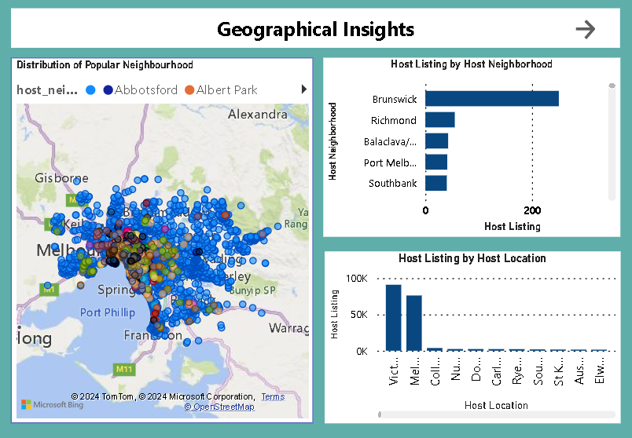

Slide 7
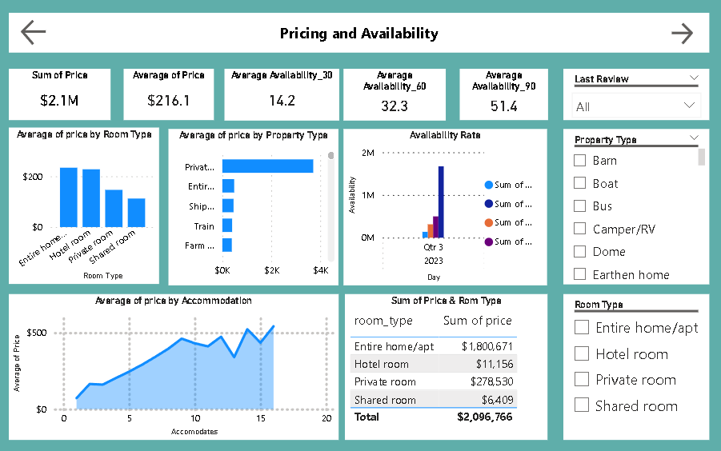

Slide 8
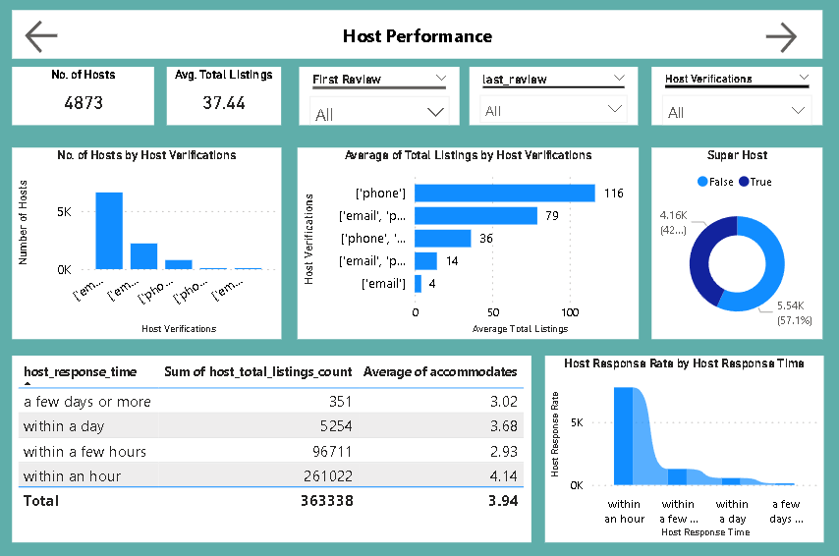

Slide 9
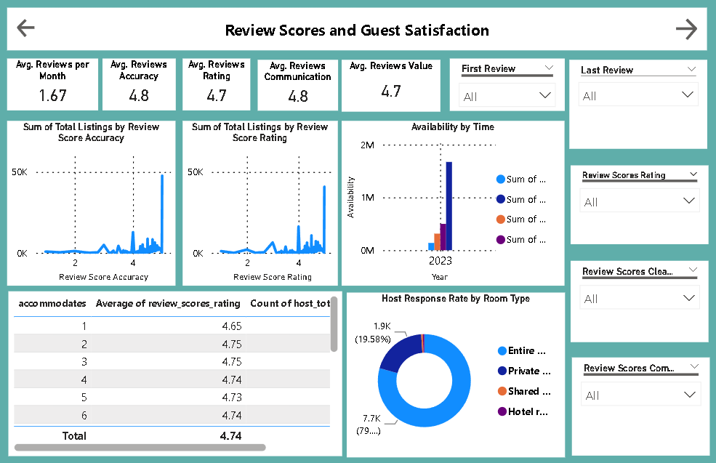

Slide 10
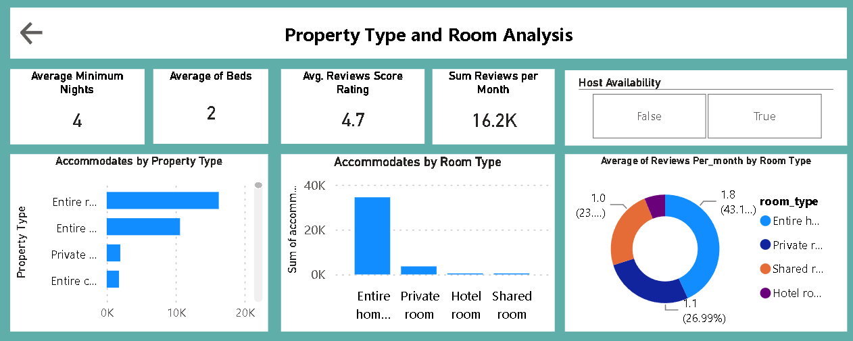

Slide 11
4. Conclusions
The city with the most listings is Melbourne, Australia, with 800listings spread across 30neighborhoods.
The highest availability of listings occurred in March 2020, January, April, and August 2023, for durations of 30, 60, 90, and 360 days, respectively.
Factors influencing guest satisfaction include cleanliness, amenities, communication, and overall experience.

Slide 12
4. Conclusions
Capacity of accommodation doesn’t have a proportional relationship with the price.
The shared room type is the only type that can be affordable.
The response rate doesn’t affect the super host status.
There is a strong and clear proportional relationship between the count of total reviews and the total listings count. Thus, giving more the opportunity for rating makes the hosts more popular.

Slide 13
4. Conclusions
The majority of listings are entire rental units, indicating a strong demand for whole properties.
Property types such as Yurts, Barns, Boats, and Buses have a low presence in the listings, suggesting an opportunity to diversify offerings.

Slide 14
Thanks

